Slide 1
Sprint Demo 2
Industry project - grow box

Slide 2
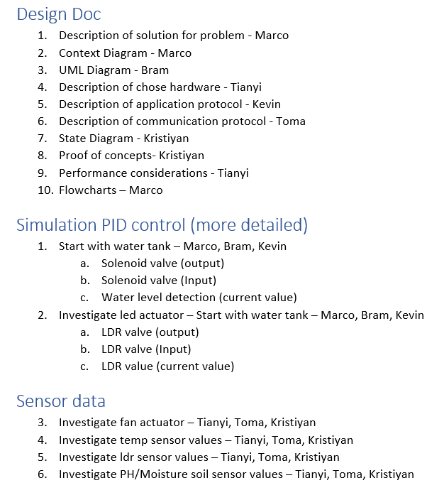
What we promised

Slide 3
What we achieved
Concrete idea for our project
Completed documentation
Water tank simulation (Rich-shield)
C# app to display some sensor data (simulate grow box values)

Slide 4
Retrospective
What went wrong?
Missing a couple of sensor/actuator for demo
Fan
PH sensor (we just received it at ISSD)

Slide 5
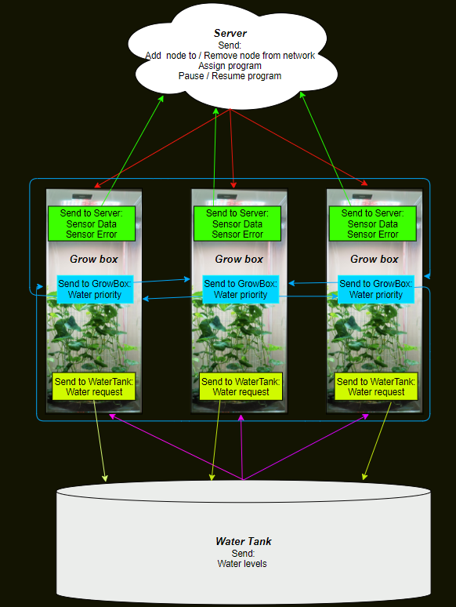
System Architecture
For each system, a customer purchases there could be ‘n’ amount of grow boxes but there is always going to be a server and a water tank.
The water tank being the main supply to distribute the water among all grow boxes.
The server being the main user interface, the c# app.

Slide 6
Quick Demo

Slide 7
Sprint Demo 3
Set up ESP32 to MQTT broker server
Finish communication protocol
Connect a Fan / PH sensor
Control one Grow-Box with node-red
Ex: Turn on / Turn off led with node-red dashboard
Visualize data with dashboard
Control fan speed

Slide 8
Questions?

